Slide 1
Women CA’s Practice “Management Skills and Benefits”
WMEC of the ICAI
Virtual CPE Meeting
CA. Petchi Kannan
Chennai

Slide 2
Present Position
Gender Equality
Women in Arm Forces
Women CAs in the year 2000 (8%), 2012 (20%) and in 2020 (25%)
ICAI is having more commitment to develop Women CAs empowerment

Slide 5
Don’t wait for extra-ordinary opportunities seize common occasions and make them great.

Slide 6
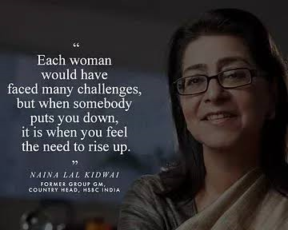

Slide 8
Awake.. Awake... To Save World
Create Awareness
Plant trees
Save Nature

Slide 9
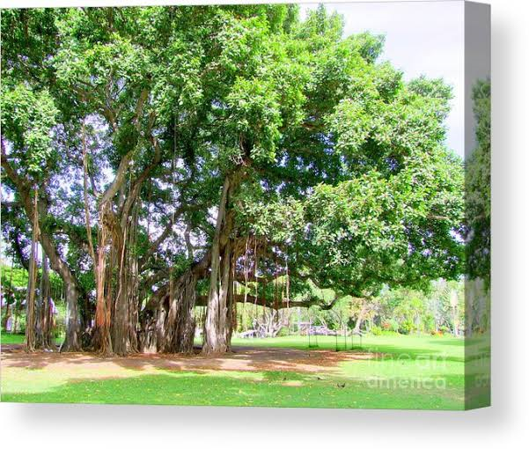
Banayan Tree Bamboo Tree

Slide 10
TULSI PLANT

Slide 11
Natures Free Gift

Slide 12
O2 Factory for the Generation Next !!

